Slide 1
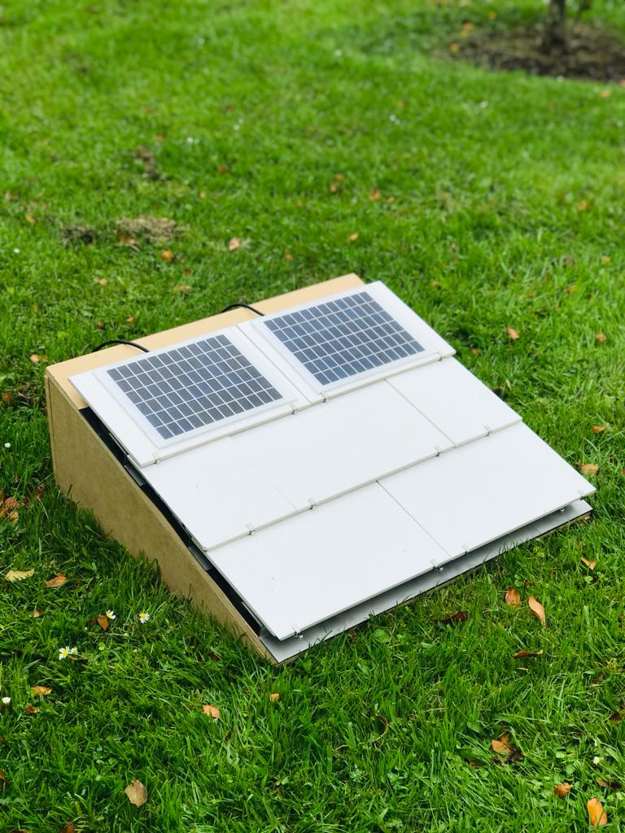
OPTIMAL STRUCTURAL DESIGN AND PROTOTYPING OF CONNECTORS TO SUPPORT ROOF MOUNTED SOLAR TILES
Group Members:
Sreeshob S Anand
Nived Rajan
Nikhil Thomas
Tony Pauly
Supervisor:
Dr. Muhammed Al-Rawi

Slide 2
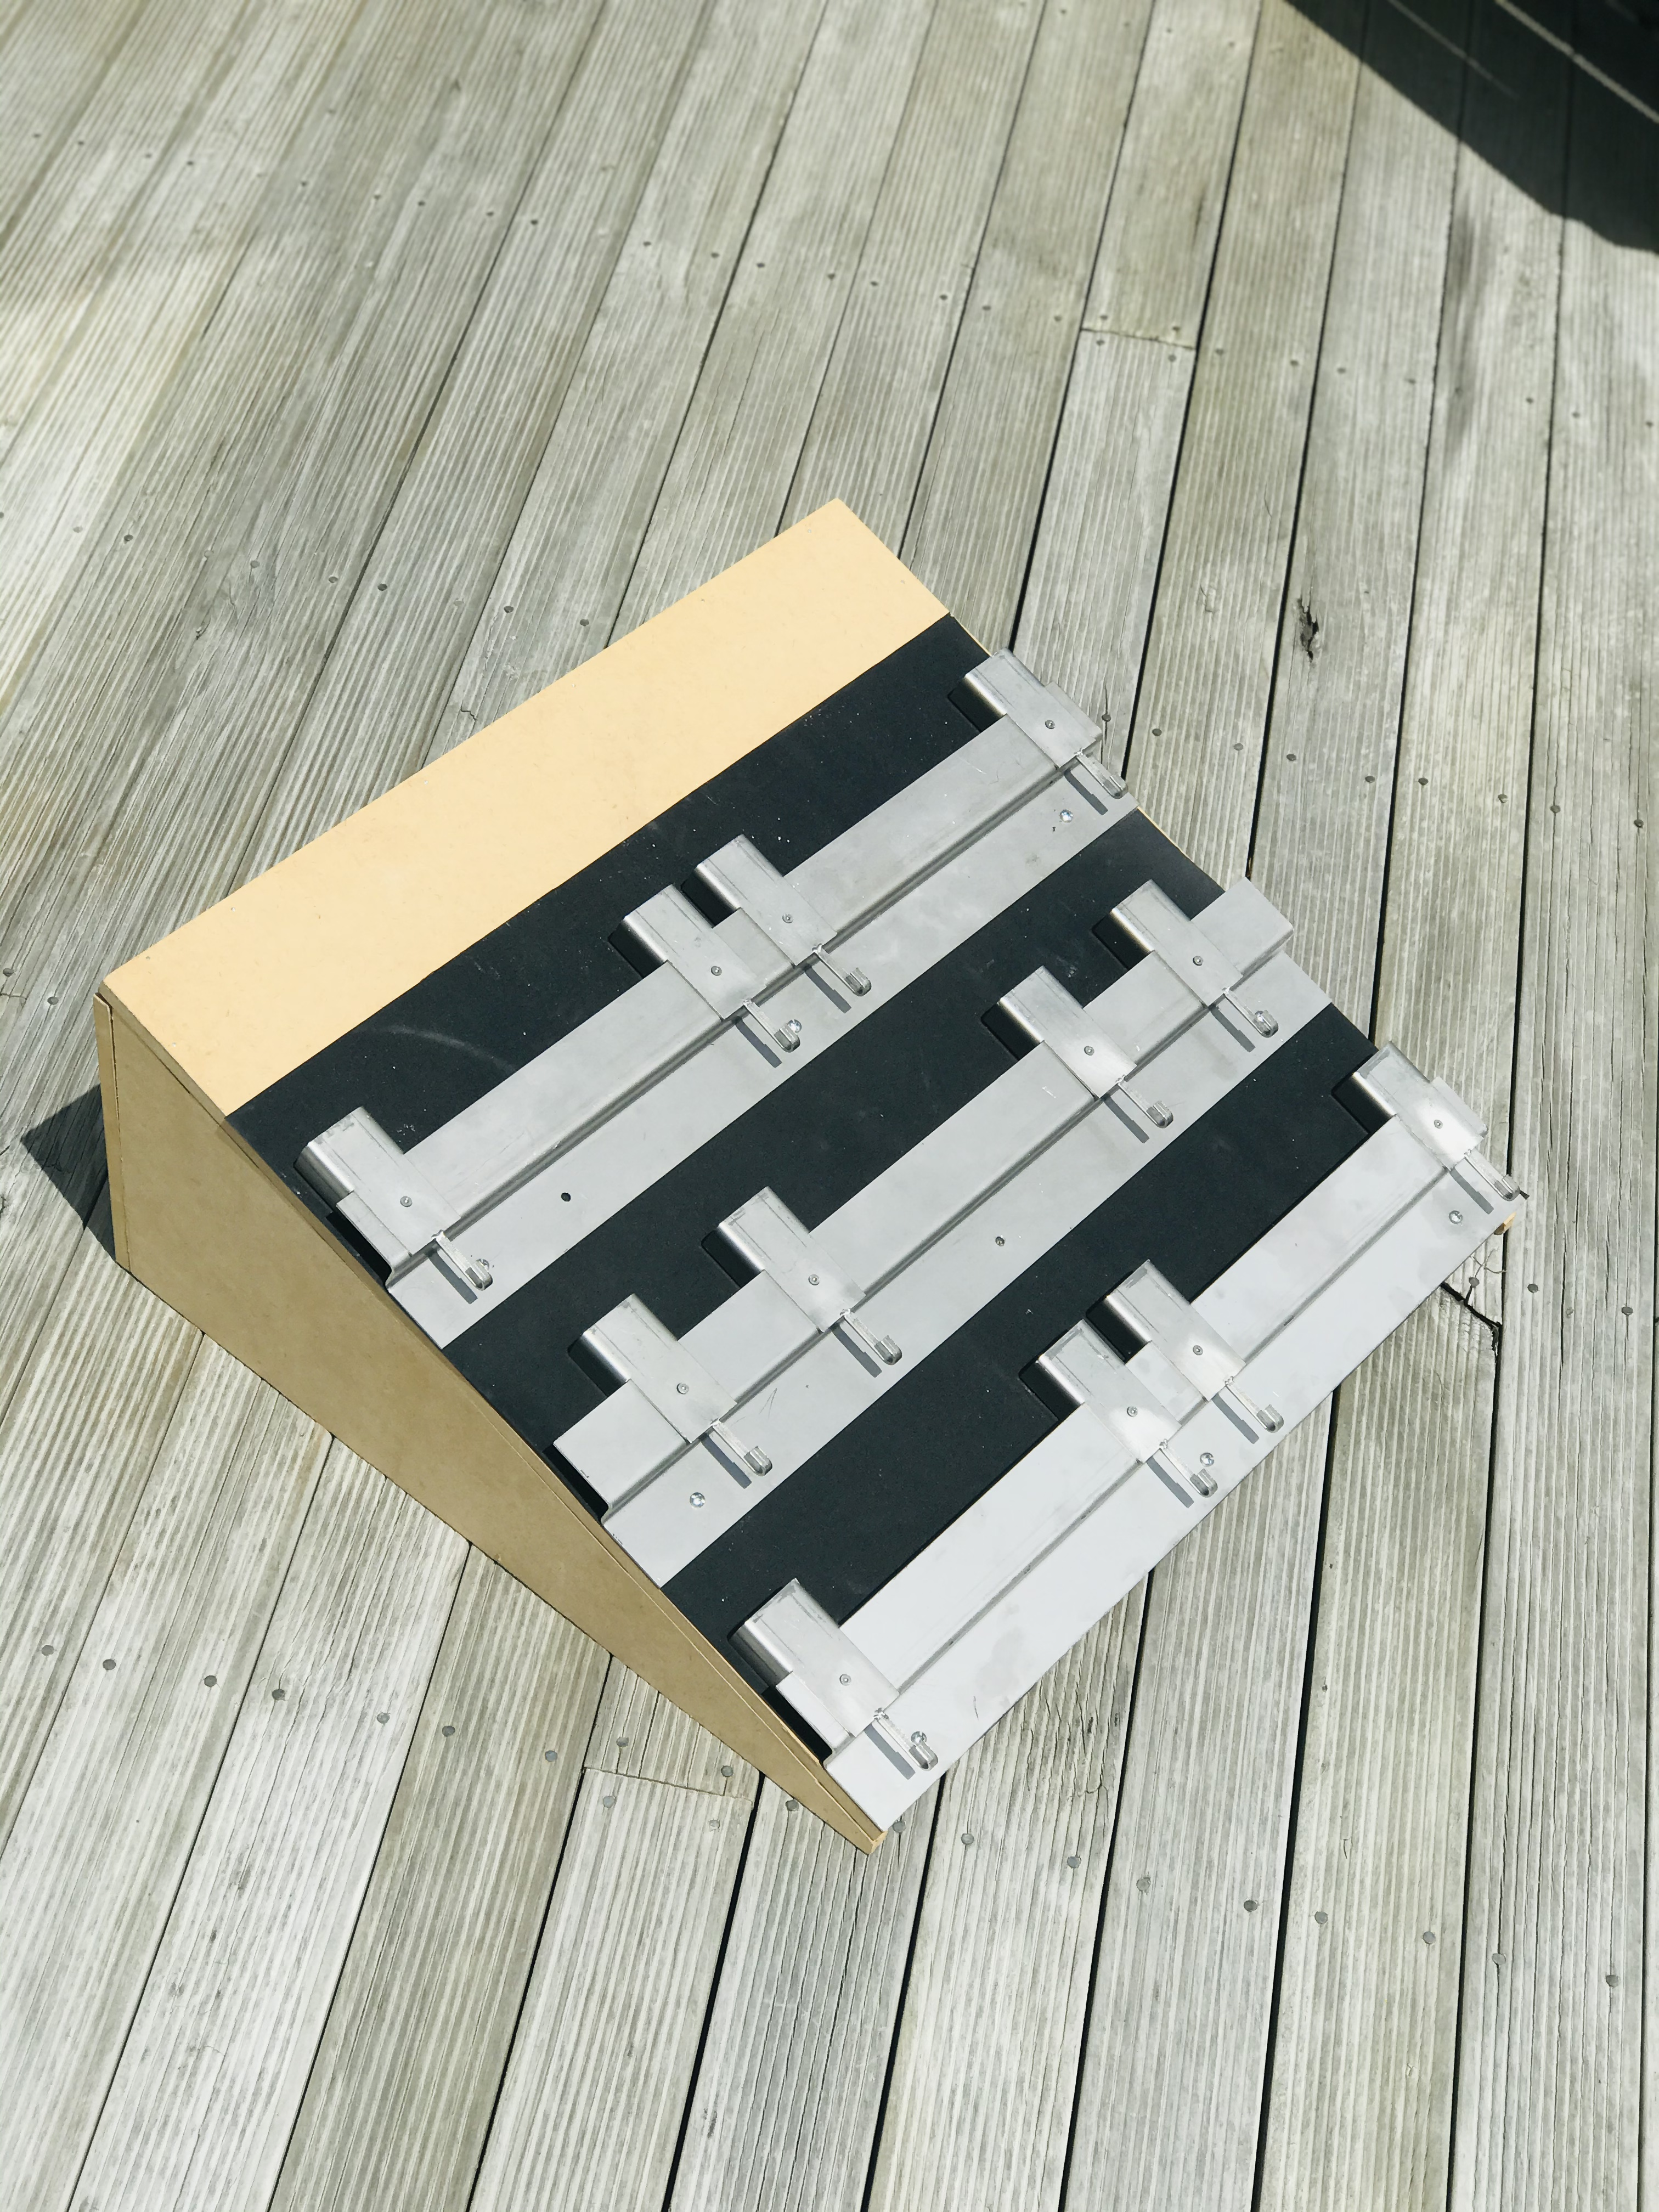
Abstract
A well-engineered solar roof tiles mounting system is presented here by eliminating the drawbacks of the solar roof. The innovative design presented here is easy to install and can accommodate a range of solar tiles manufactured by leading manufacturers. The design also solves the overheating of the solar tiles, roof leaking issues, tilting of the tiles, and corrosion of mounting units.

Slide 3
Current Issues
Over heating of solar tiles
Structural damage
Roof leakage
Corrosion

Slide 4
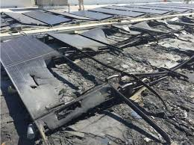
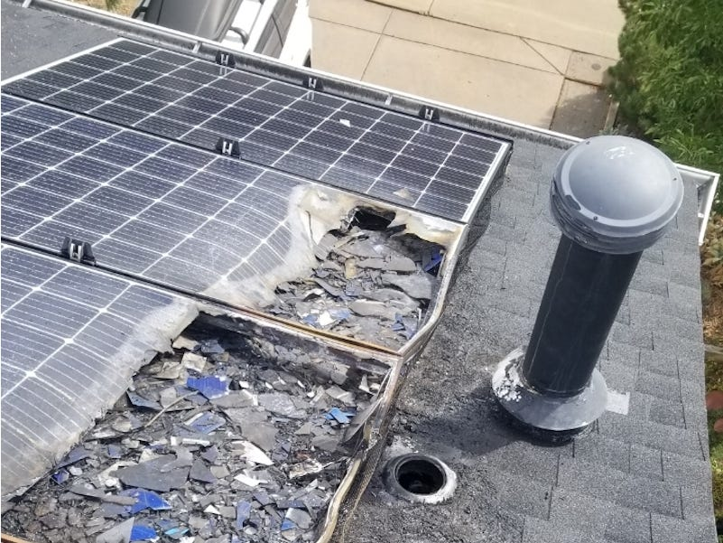
The overheating issues of solar roof tiles and associated safety concerns
Roof mounted solar tiles heats more than 60 degree Celsius.
Thus causing roof fires.
Unlike solar panels there is less air circulation between the tiles.

Slide 5
Structural damage of solar roof tiles due to external wind loads
Mounting unit fails to withstand the force
High speed of winds in NZ
Poor Installation

Slide 6
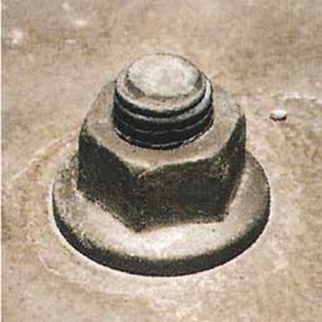
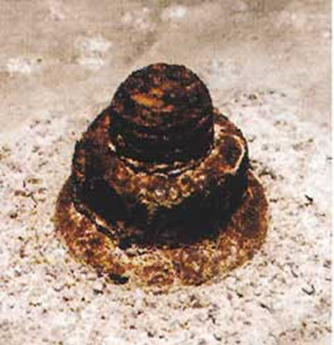
Corrosion of the solar roof tiles mounting units
Both anode and cathode contain metals in assembly.
Rainwater acts as the electrolyte leads to corrosion.
Less noble metals
Solar tiles mounting unit Before Corrosion
Solar tiles mounting unit
After Corrosion
Stainless steel bolt & nut
Used to mount solar tiles
Iron clamping unit used to mount solar tiles

Slide 7
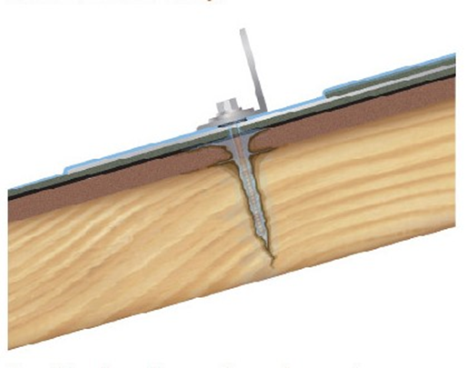
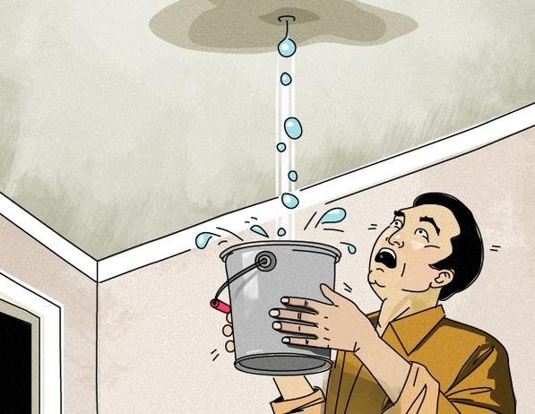
Roof leakages due to solar tiles installation
Drilling many holes
Poor Installation
void the roof warranty

Slide 8
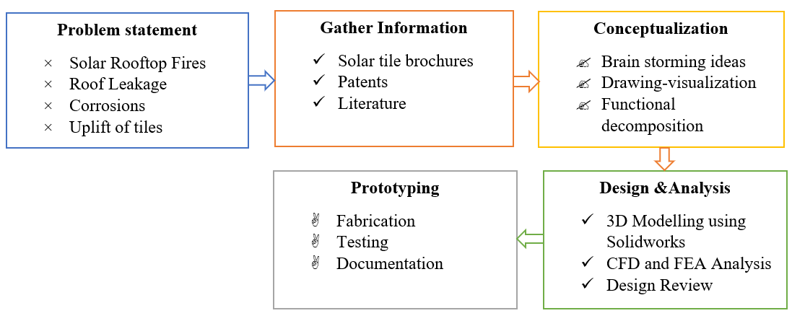
Design Methodology

Slide 9
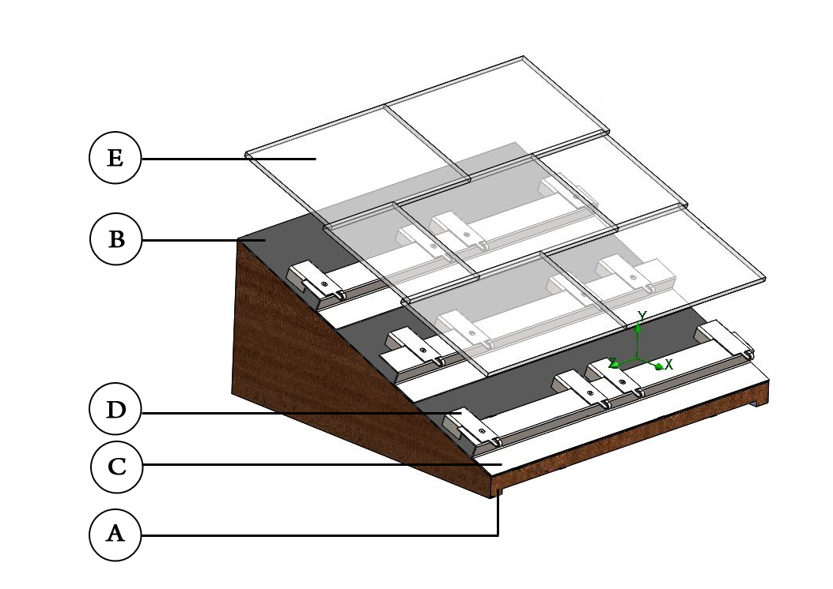
Design

Slide 10
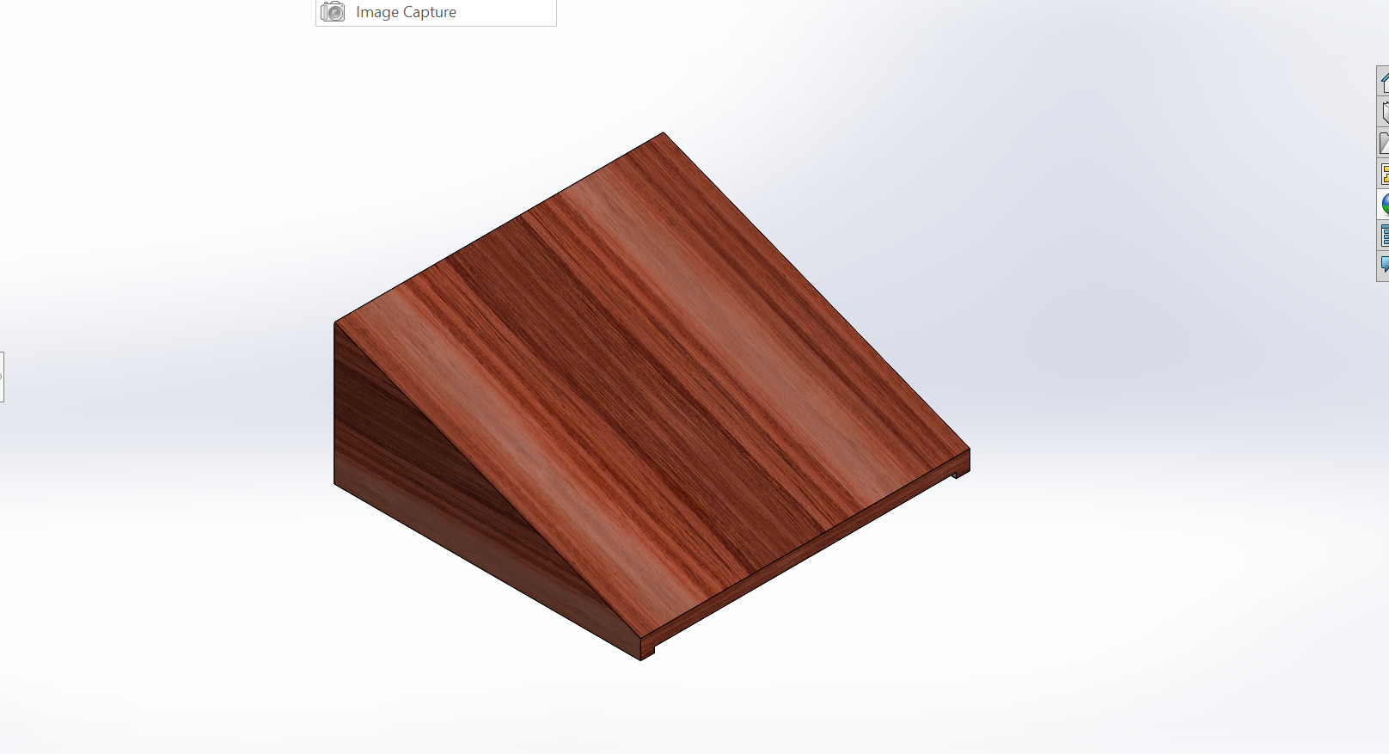
A. Wooden Roof
Pine wood
Mono-pitch roof with an angle of 60
very cost-effective and are widely seen in New Zealand

Slide 11
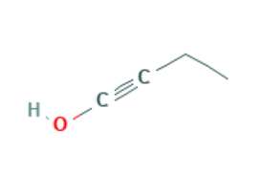
B. Waterproofing Sheet
Does not allow water to seep
Eliminates the roof leakage
Butynol is a synthetic rubber membrane
Superior gas impermeability and toughness, remains flexible at high and low temperatures

Slide 12
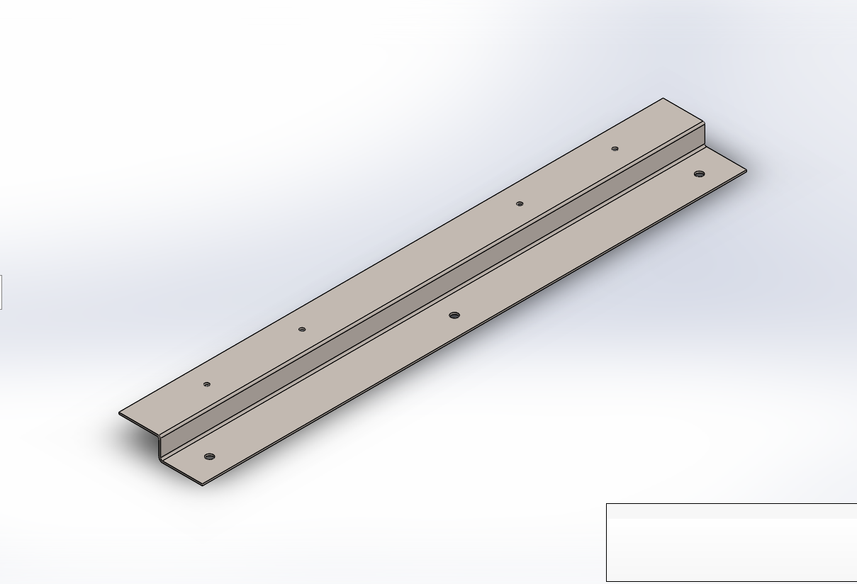
C. Battens
Function of battens is to secure the link channels and tiles onto the roof
Roof pitch to go low as 5 degrees
Stainless Steel grade 316

Slide 13
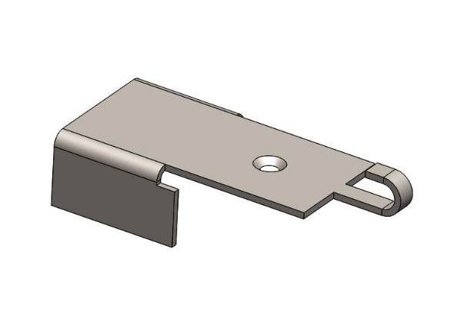
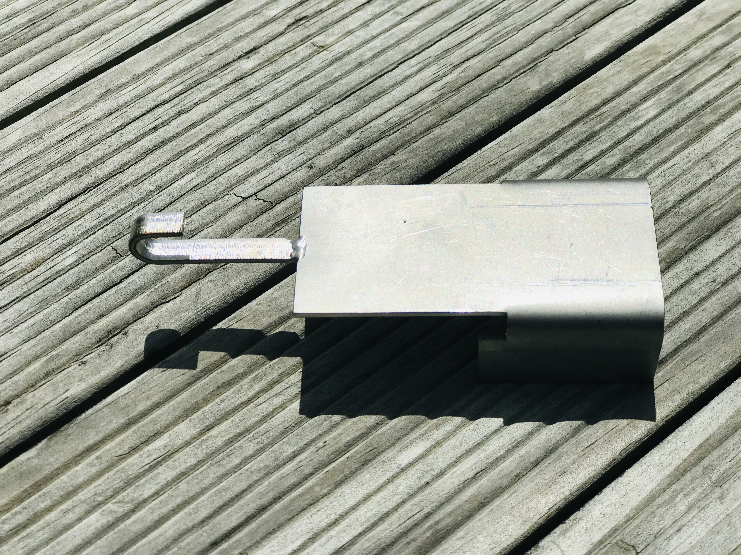
D. Link Channels
Stainless Steel grade 316
Secured locking mechanism is used to space the batten to accommodate solar tiles
Excess rainwater flows into the link channel then out onto the tile below

Slide 14
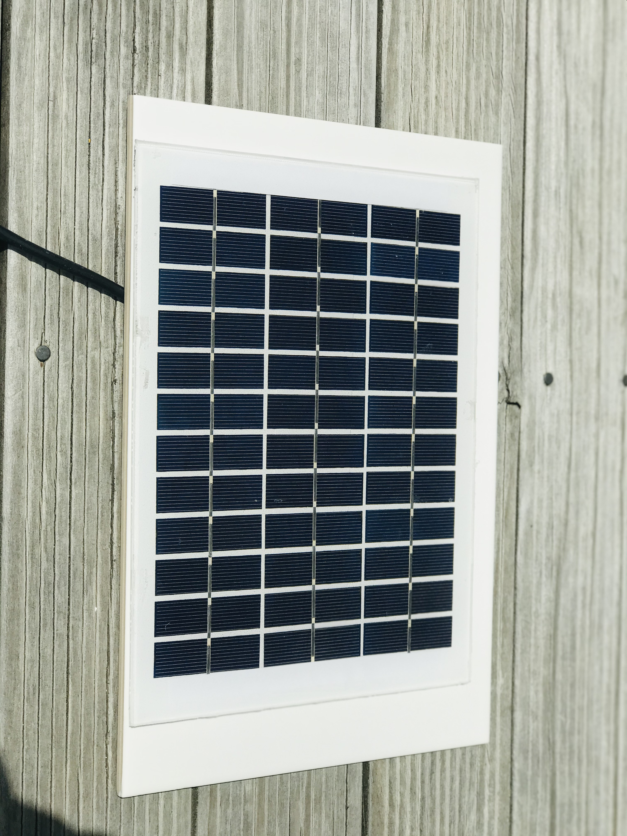
E. Solar Tiles
Product Description | Parameters
Solar panel type | Monocrystalline
Open circuit voltage | 21.8V
DC Voltage | 12.0V
Maximum power | 5.0V
Power connector | Alligator clips
Dimensions | 251 x 205 x 18
Weight | 0.67 kg

Slide 15
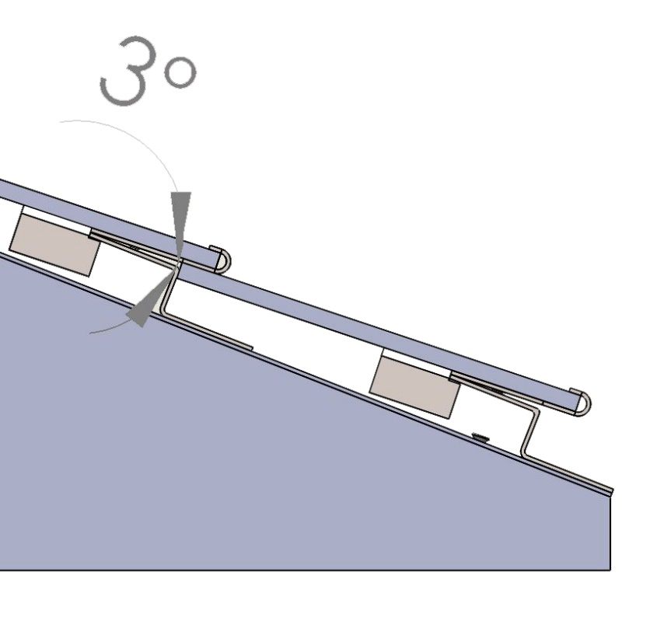
Design Features
Eliminates the roof fires
Small fraction of nominal surface of the solar tiles is in contact
Uniform flow of heat is generally restricted
Limited contact area between the link channel and battens

Slide 16
Design Features
Eliminates corrosion
Composition | SS316 (wt%)
Carbon (C) | 0.08 Max
Manganese (Mn) | 2.00 Max
Phosphorus (P) | 0.045 Max
Sulphur (S) | 0.030 Max
Silicon (Si) | 0.75 Max
Chromium (Cr) | 16.00 -18.00
Nickel (Ni) | 10.00 – 14.00
Molybdenum (Mo) | 2.00 -3.00
Nitrogen (N) | 0.10 Max
Iron (Fe) | Balance
Stainless steel grade 316
Contains molybdenum which increases corrosion resistance

Slide 17
Design Features
Eliminates Roof Leakage
Waterproofing sheets adds extra layer of protection.
Less number of holes drilled on to the roof.
Counter sunk screws are used to clamp the battens and link channels.

Slide 18
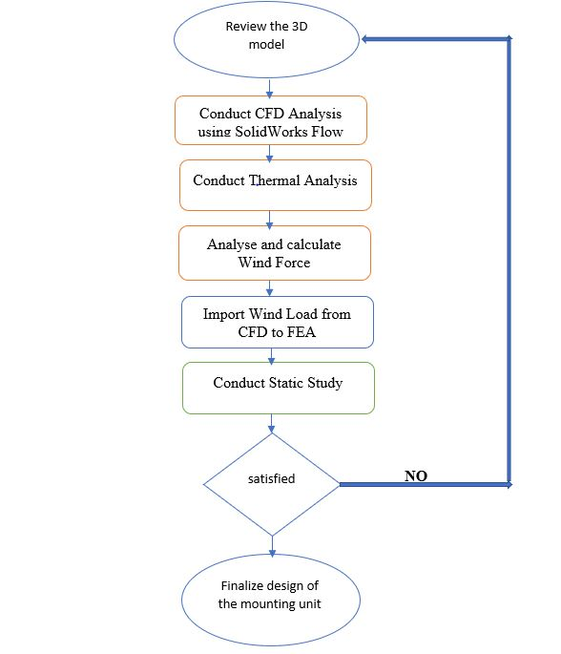
Design Validation
Simulation-driven design process
Combined CFD and FEA analysis
Solidworks is used for the analysis

Slide 19
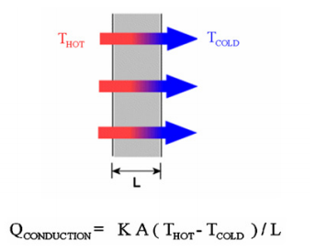
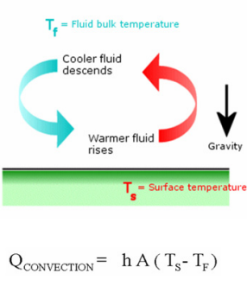
Thermal Analysis
WIZARD SETUP
Unit system | SI(m-kg-s)
Analysis Type | Thermal analysis by conduction and convection
Fluid | Air at 10°C
Velocity of wind in X direction | 40 m/s
Pressure | 101325 pa
Temperature distribution
Temperature gradient
Heat exchange

Slide 20
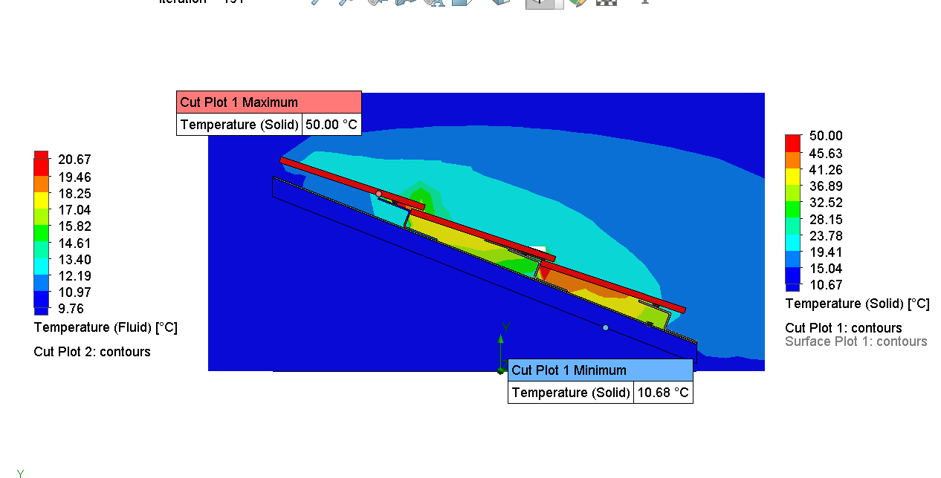
Thermal analysis results

Slide 21
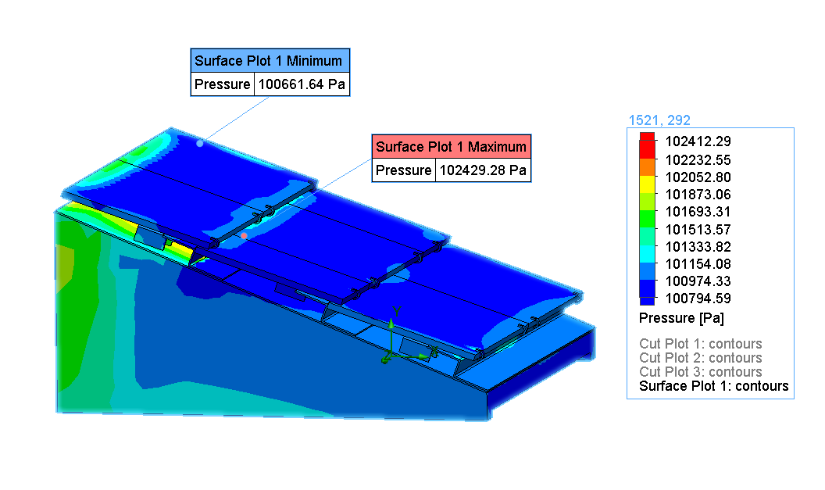
Pressure distribution plot
Maximum pressure is 102429 pa

Slide 22
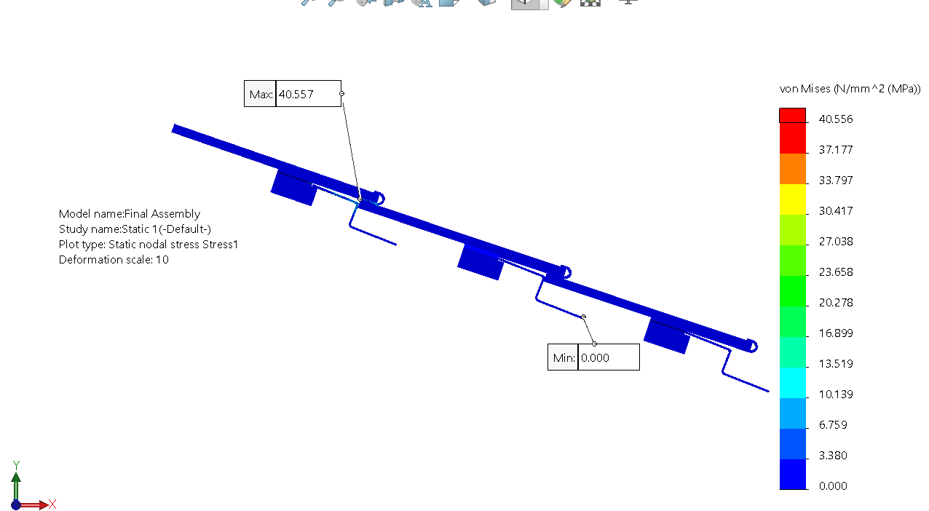
Von mises stress plot
Von mises stress determines if the given material will yield or fracture
Maximum obtained von mises stress plot value is 40.557 Mpa
Obtained value is less than the yield strength of the materials

Slide 23
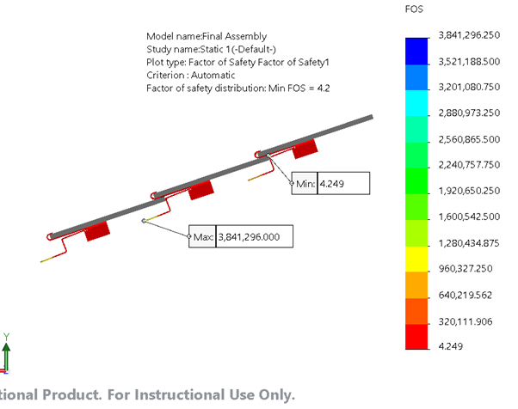
Factor of safety plot
FOS is the ratio of allowable stress to the actual stress
FOS greater than 1 signifies stress is at permissible limit.

Slide 24
Fabrication

Slide 25
Fabrication
Laser Cutting
Bending
Countersunk
Welding
Tapping

Slide 26
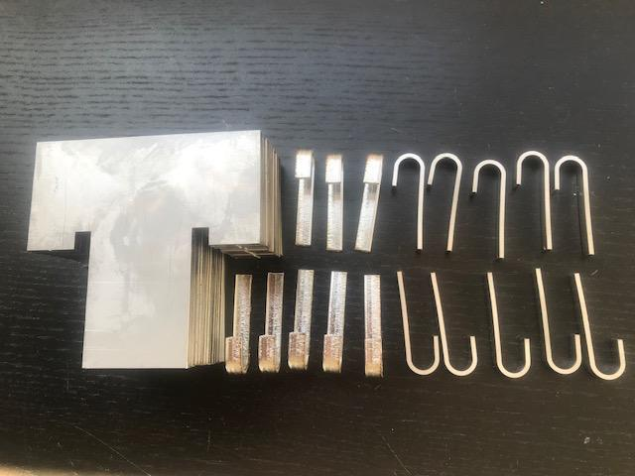
Laser Cutting
Cut metals more precisely
Machine Make | Trumpf
Laser source | 1000W
Nozzle diameter | 1.5 mm

Slide 27
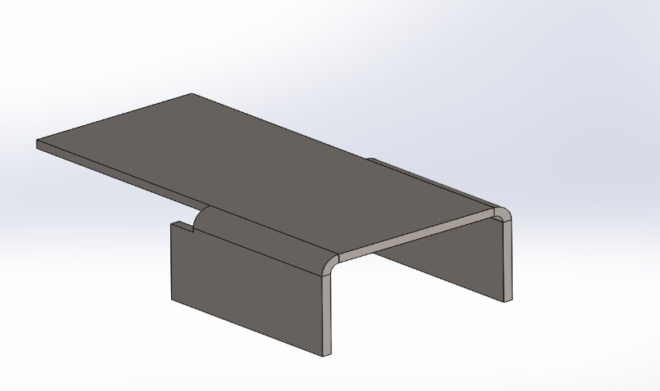
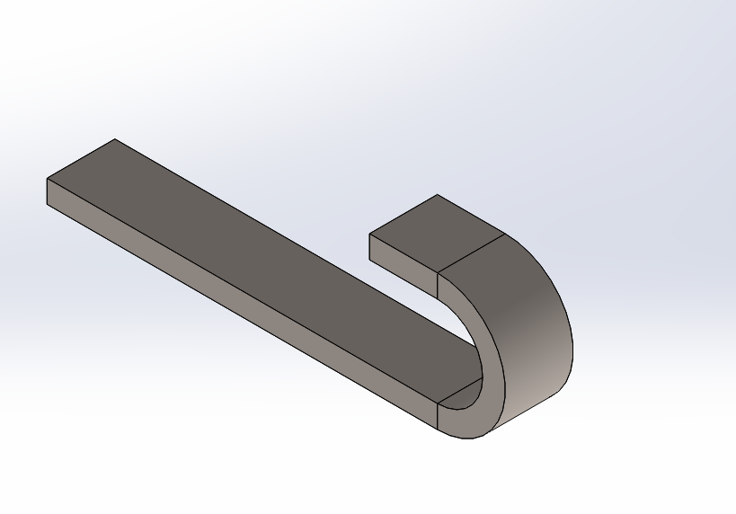
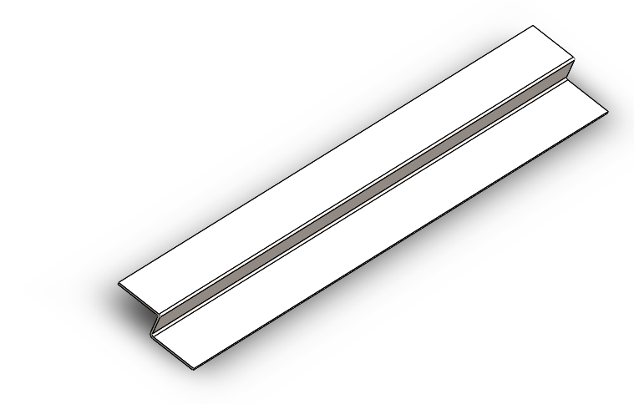
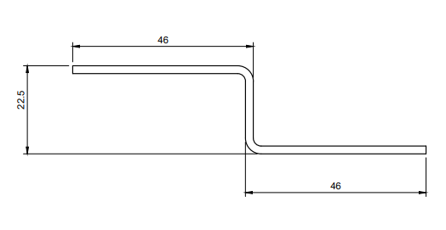
Bending
Total of five 90 degree bends
BA = $\frac{π}{180}∗Bend Angle\left(IR+K∗MT\right)$

Slide 28
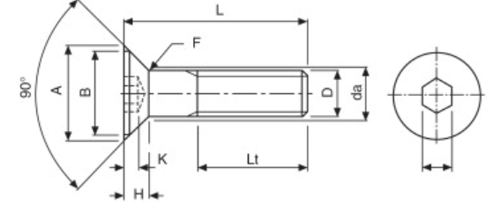
Countersunk for link channel
thoroughly flush with the top surface to avoid any interference
Parameters used | M3 Type
Relief hole | 3.5mm
A maximum | 6.7 mm
B minimum | 5.8 mm
Head depth H | 1.8 mm

Slide 29
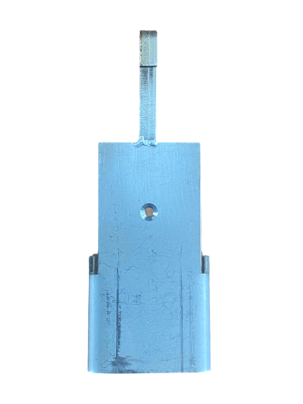
Welding
Tungsten inert gas welding (TIG welding) process
Material | Material thickness | Polarity | Amperage | Tungsten Diameter | Filler Material | Gas flow rate | Type of gas
Stainless steel | 3/32’’ | DC | 80-120 | 1/16’’ | SS316 | 12 | Argon

Slide 30
Drilling and Tapping
Battens are drilled and tapped
Tap chart -Metric thread
Tap size | Basic major dia (mm) | Drill size (mm)
M3 X 0.5 | 3mm | 2.5mm

Slide 31
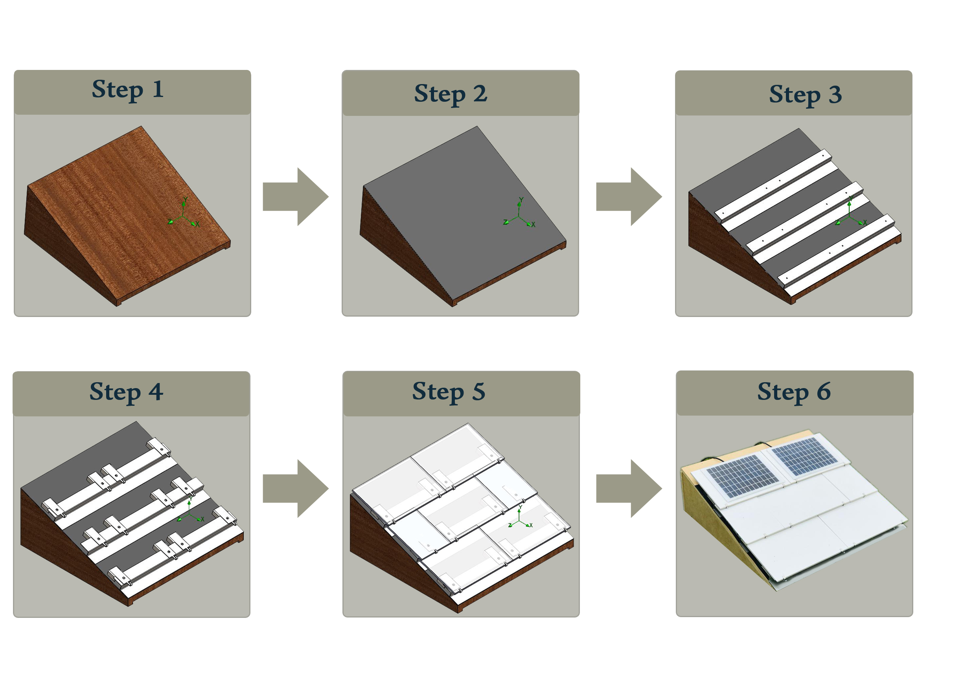
Assembly Stages

Slide 32
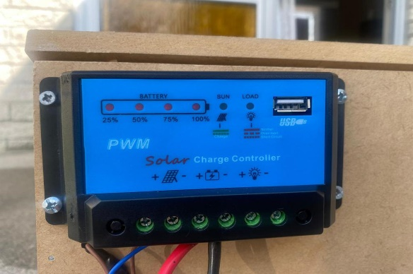
Electrical Components and connections
Name | Image | Specification | Function
Charge Controller |  | 10A Max Solar input: <10mA Operating temperature: 35~60 degree C | The solar charge controller controls the energy emerging from the Photovoltaic array and transfer it directly to the batteries as a Direct Current-coupled system.

Slide 33
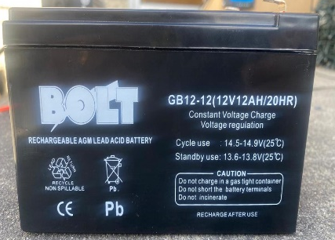
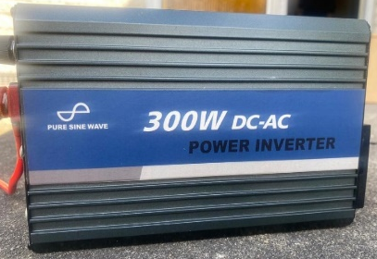
Electrical components and connections
Battery |  | 12V 12AH/20HR | The battery here stores the energy generated by the solar panels for later use.
Inverter |  | 300W DC-AC | The inverter converts direct current (DC) power generated by solar panels to alternate current (AC).

Slide 34
Testing
Temperature difference
Solar Output
Water leakage

Slide 35
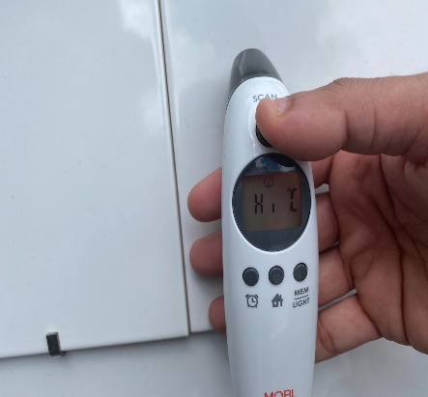
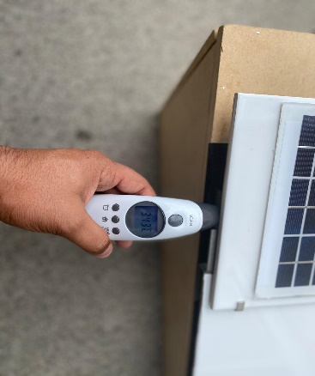
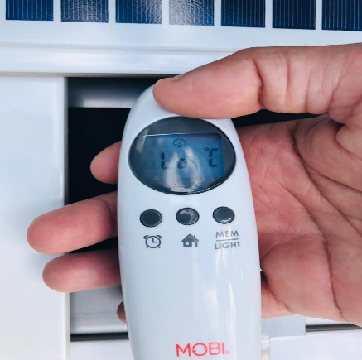
Temperature difference
Name of Component | Images | Maximum Temperature in °C
Solar Tiles |  | Maximum recorded temperature: 42.6°C
Link channels |  | Maximum recorded temperature: 34.7°C
Battens |  | Maximum recorded temperature: Lower than 30°C

Slide 36
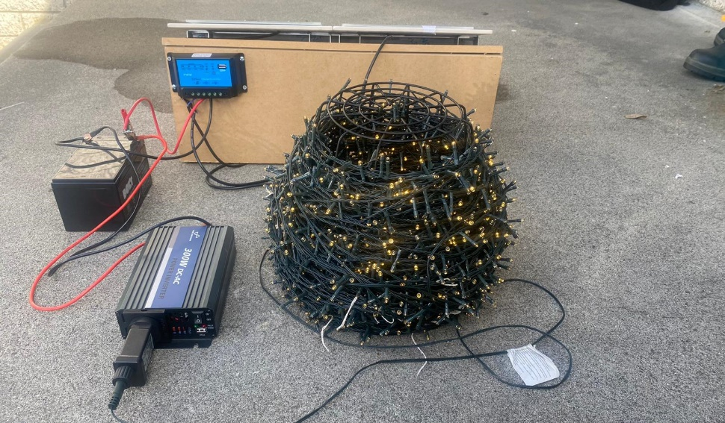
Solar Output
Output from solar cells is determined by the amount of sunlight it is exposed.
Climate and location also plays an important role

Slide 37
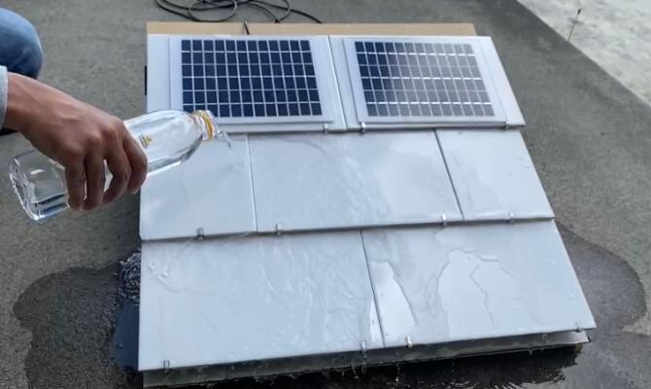
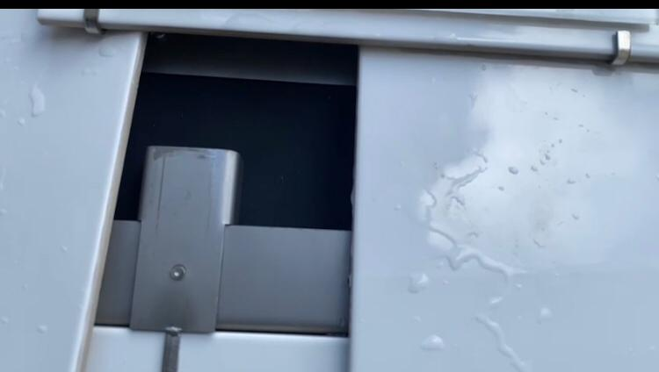
Water Leakage
Water hits the tiles, the excess water flows into the link channel then out onto the tile below, keeping the roof and waterproofing membrane dry

Slide 38
Limitations
Actual dimensions of the existing solar tiles from leading companies like tesla is confidential.

Slide 39
Conclusion
1.
2. This design proved that heat generation is not transferred into the roof due thermal contact resistance
3. Stainless-steel grade 316 is used for the fabrication of the link channel and battens which contains molybdenum, which prevents corrosion.
4. This design avoids tilting of tiles due to heavy wind(up to 50 m/s)

Slide 40
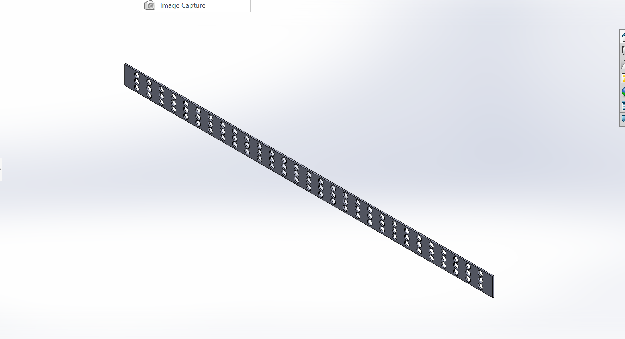
Future Recommendations
1. Use integrated solar tiles
2. Perforated vents covers

Slide 41
Schedule
Semester 1
Semester 2
Initial Phase
Design Phase
Day 1
Day 40
Day 5
Day 7
Day 1
Day 3
Day 4
Day 7
Analysis Phase
Fabrication and testing

Slide 42
Bibliographical References
Dassault systems. (2020). SOLIDWORKS Simulation. Retrieved 28 October, 2020, from https://www.solidworks.com/product/solidworks-simulation.
Dheev, N. Concept Generation. Engr.uvic.ca. Retrieved 24 June 2020, from https://www.engr.uvic.ca/~mech350/Lectures/MECH350-Lecture-4.pdf.
Properties of Type 316 and 316L Stainless Steels. ThoughtCo. Retrieved 15 June 2020, from https://www.thoughtco.com/type-316-and-316l-stainless-steel2340262#:~:text=Type%20316%20steel%20is%20an,increases%20strength%20at%2 0high%20temperatures.
US6453629B1 - Roofing tile having photovoltaic module to generate power. (n.d.). Retrieved from https://patents.google.com/patent/US6453629B1/en

Slide 43
Testing Phase (cont..)

Slide 44
Thank you ☺

Slide 45
Any Questions??

